Slide 1
PROFILING ML WORKLOAD
DeepSeek-V4-Flash
From model card to hardware-mapping traces — step by step
8 context lengths × 3 accept-rates = 24 trace files

Slide 2
ARCHITECTURE SNAPSHOT
What is DeepSeek-V4-Flash?
284B / 13B
43
4,096
total / activated params
layers (2 SWA + 21 CSA + 20 HCA)
hidden size
1 + 256
1,000,000
MTP depth 1
shared + routed experts (6 active/tok)
tokens native context
"DSpark" speculative module, block 7
DeepSeek-V4-Flash — Profiling ML Workload
2

Slide 3
THE CORE DISTINCTION
Two things are fixed. Two are not.
=
Deterministic
?
Stochastic
Hash routing
First 3 MoE layers — a deterministic function of token ID. Zero probability involved.
Kernel shapes & weights
Fixed the moment the architecture is fixed — FLOPs and bytes are formulas, not draws.
Learned routing
40 of 43 layers — top-6 of 256 experts by affinity score. Needs a profiled histogram to characterize.
MTP accept-rate (α)
k tokens accepted per draft block is sampled each iteration — governs how long the DAG loop runs.
This is why we need a sweep across scenarios — not one number.
DeepSeek-V4-Flash — Profiling ML Workload
3

Slide 4
1
Pull architecture inputs
From the DeepSeek-V4 technical report, Section 4.2.1
Layers
43 (2 pure-SWA + 21 CSA + 20 HCA, interleaved)
Hidden size
4,096
Attention compression
CSA: compress every 4 tokens → 1 entry, top-512 sparse select
HCA: compress every 128 tokens → 1 entry, dense
MoE
1 shared expert (always fires) + 256 routed (6 active/token)
Speculative module
MTP depth 1 — what vLLM/SGLang brand "DSpark", block size 7
Vocab
~128K (paper: "remains 128K", not given more precisely)
DeepSeek-V4-Flash — Profiling ML Workload
4

Slide 5
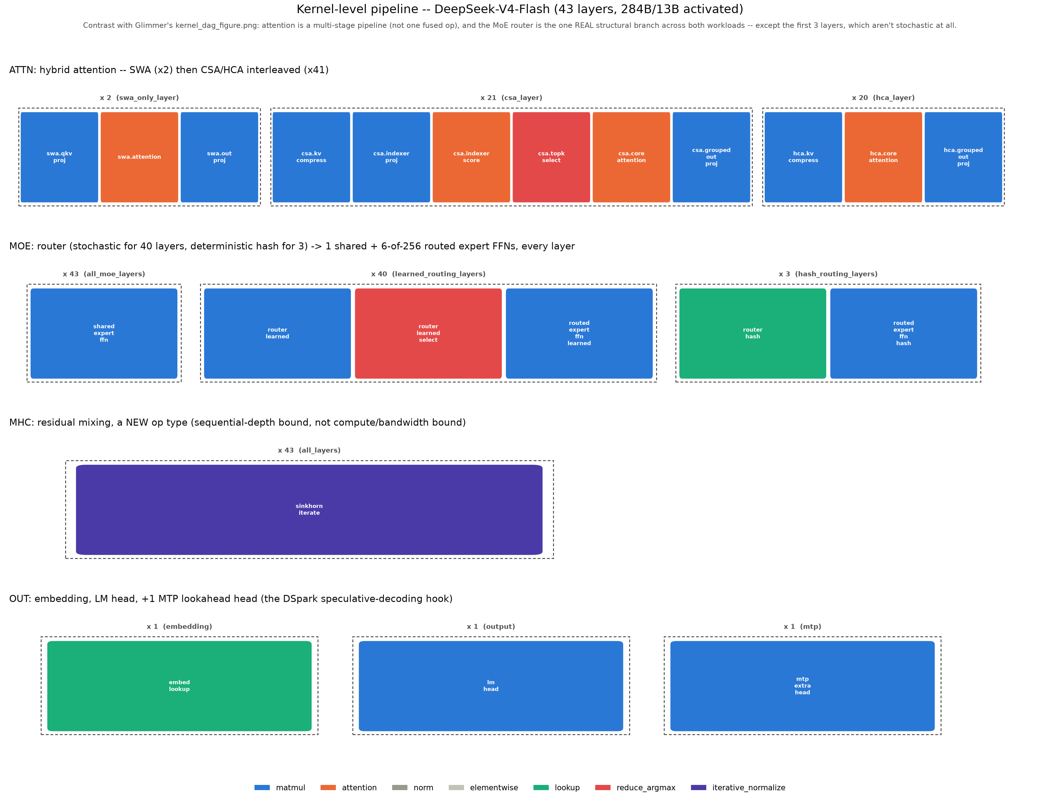
2
Decompose into kernels
deepseek_kernels.py — 22 kernel definitions across 4 task groups
DeepSeek-V4-Flash — Profiling ML Workload
5

Slide 6
3
Derive two formulas Glimmer didn't need
DeepSeek's compressed KV cache and lightweight MTP drafter have no Glimmer analog
KV bytes / token
MTP draft-step cost
Amortized from DeepSeek's own compression ratios:
Real MTP modules are one lightweight extra block reusing the shared output head — NOT a full 43-layer pass, and structurally unlike Glimmer's separate small draft model.
21 CSA × (512·1 + 128·0.5)/4 + 20 HCA × (512·1)/128
3,104 B
≈ 1/43
per token
(growing-KV part only)
of a full forward pass,
run 7× sequentially per iteration
vs. Glimmer's 53,248 B/token → 17.2× smaller
APPROXIMATION — real MTP module width isn't published. Not a sourced number.
DeepSeek-V4-Flash — Profiling ML Workload
6

Slide 7
4
Build the DAG loop
PREFILL once → [MTP_DRAFT × 7 → VERIFY → COMMIT] until EOS
PREFILL
MTP_DRAFT
VERIFY
COMMIT
exit
(EOS / max len)
arrival
43-layer pass
over L tokens
7 sequential
micro-steps
43-layer pass
over 7 tokens
accept k of 7
k ~ TruncGeom(α)
loop until EOS — the ONLY stochastic quantity is k, not which edge fires
New edges vs. Glimmer: PREFILL→COMMIT carries the compressed KV publish (grows with L) • VERIFY→COMMIT carries k × 3,104 B + context carry
DeepSeek-V4-Flash — Profiling ML Workload
7

Slide 8
5
Decide the sweep — before generating anything
Uniform across 256 experts
Routing
No profiled data exists yet — an honest no-information placeholder, not a measurement.
Paper's own Fig. 9 checkpoints
Context length
8K, 16K, 32K, 64K, 128K, 256K, 512K, 1024K — doubling, spans the full 1M-token validated range.
0.65 / 0.75 / 0.85
Accept-rate α
Reused from Glimmer's placeholder bounds — flagged as unconfirmed for DeepSeek specifically.
8 context lengths × 3 accept-rates = 24 combinations
DeepSeek-V4-Flash — Profiling ML Workload
8

Slide 9
6
Generate the traces
deepseek_workload_dag.py — 24 files, one per (α, L) combination
DeepSeek-V4-Flash — Profiling ML Workload
9

Slide 10
WHAT WE FOUND
Three things worth carrying forward
17.2× smaller KV footprint
Falls straight out of DeepSeek's own compression ratios (m=4 CSA, m'=128 HCA) — not tuned to match the paper's efficiency claim, it just lands there.
Iterations depend only on α
45 / 33 / 23 iterations at α = 0.65 / 0.75 / 0.85 — completely flat across all 8 context lengths. L and α are independent axes.
Compute grows super-linear, not quadratic
128× more context → 574× more prefill FLOPs. Compression tempers the O(L²) attention term without eliminating it.
All 24 trace files, the loop simulator, and every formula above are pushed to the repo under “Profiling ML workload/”.
DeepSeek-V4-Flash — Profiling ML Workload
10

